Slide 1
DEBT-DEFYING BUDGET BUDDY
DEBT-DEFYING BUDGET BUDDY
A Personal Finance Management Tool
Anvitha Chaluvadi, Maria Notarianni, Owura Fosuhene Akosah

Slide 2
CORE MESSAGE/HYPOTHESIS
Budgeting is an important but time-consuming task. By automating the process of tracking spending habits, users can see quickly where their dollars are going, learn how to optimize their income, and compare their financial health to the national average.

Slide 3
QUESTIONS & MOTIVATION
How is our “test user” spending their income each month?
How does this user measure against the average person in the U.S.?
Are there insights that our user can gain from monitoring their budget?
Can they create healthy spending habits and increase their monthly savings?
When (and how much) someone is able to start saving has lifelong implications. It determines when (or if) someone can pursue an advanced degree, make a downpayment on a home, or retire. Building a tool that could help others see their dreams come to fruition is cool!

Slide 4
SUMMARY FINDINGS
Through data organization, we were able to see when and how much this sample user spends by category and month.
We researched national spending averages and compared user data with national averages
By filtering user’s spending by category, users can see where their dollars are going, which categories they would like to trim back (or spend more) on, and how their savings goals can become lifetime dreams

Slide 5
QUESTIONS AND DATA
Our dataset needed to list transactions that included:
Month of transaction
Description of transaction
Amount of transaction
We used the source Kaggle to find our dataset
Sources we used to compare user data with national averages
The Ascent - American Households' Average Monthly Expenses: $6,081
Bankrate - The Average American Household Budget
ValuePenguin - Average Household Budget: How Much Does the Typical American Spend?
RentCafe - Average Rent in the U.S.
J.D. POWER - RentCafe - How Much Do People Spend On Gas Each Month?
Notes:
The project data was found on www.kaggle.com. Because our idea revolved around an individual tracking expenses, our search focused on finding a dataset of personal yearly expenses. The sample data allowed us to not only design a way to organize financial transactions by month and category but also benchmark this user’s spending against national averages.

Slide 6
DATA CLEANUP
Clean up data to identify and handle null values.
Check data types for consistency.
Drop the “Account Name" column.
Group and categorize the data.
Group data by “Month” and sum the amounts.
Convert the “Month" column to a categorical data type with a specified order.
Notes:
The data needed to be cleaned up to identify any null values, but none were found, so it wasn't included in our coding. Additionally, we needed to check for data types, drop the "Account Name" column, and group and categorize the data. Furthermore, we were required to group the data by category, sum the amounts, and convert the "Month" column to a categorical data type with a specified order.

Slide 7
DATA EXPLORATION
Insights
Account numbers - could provide a deep analysis
Problems
Account numbers - removed for a simplified, general expense statement
Interesting Finds
New data libraries
Panel - helped to create widgets, which allowed for further categorization
Sys - allows the program to stop running once user satisfaction is reached
Notes:
Insights and Problems
Did not anticipate the account numbers
overcomplicated/could confuse the user
Decided to give a general statement of expenses, regardless of method of purchase
Interesting Finds
New libraries panel and sys
Panel library helped create the widgets for the dashboard so that we could further group categories and months so that we could filter/slice the dataset as needed
Sys is a function and variable used to manipulate parts of the python run time. It allows the program to stop running once user satisfaction is reached
The sys.exit() function in Python is used to exit the program, and it raises the SystemExit exception. When this function is called, the Python interpreter terminates immediately, and the program stops executing. It can be used to forcefully exit the script or program under certain conditions.

Slide 8
DATA ANALYSIS
Confirming User Satisfaction
Asks if the user is satisfied with current spending habits
If yes, complete
If no, proceeds to next section
Summary Dashboard
Allows user to toggle between months and categories for an easier visual
Expenses from User Input (by month)
Provides a glimpse at user spending per category
New Monthly Goal
Asks users to set a budget and measure against their expenses
Lets you know if you are able to meet savings goal
Comparing National Averages
Gives users the ability to compare their spending against national averages, which indicates also what Americans financially value
Notes:
Throughout the project, our research objectives evolved. What began as an ambitious brainstorming session evolved into a realistic product. With the time we had and our current amount of knowledge, we had to be selective in our approach. We decided to focus on two of our original research questions:
What spending patterns do our users exhibit?
Are they hitting generally accepted financial goals?

Slide 9
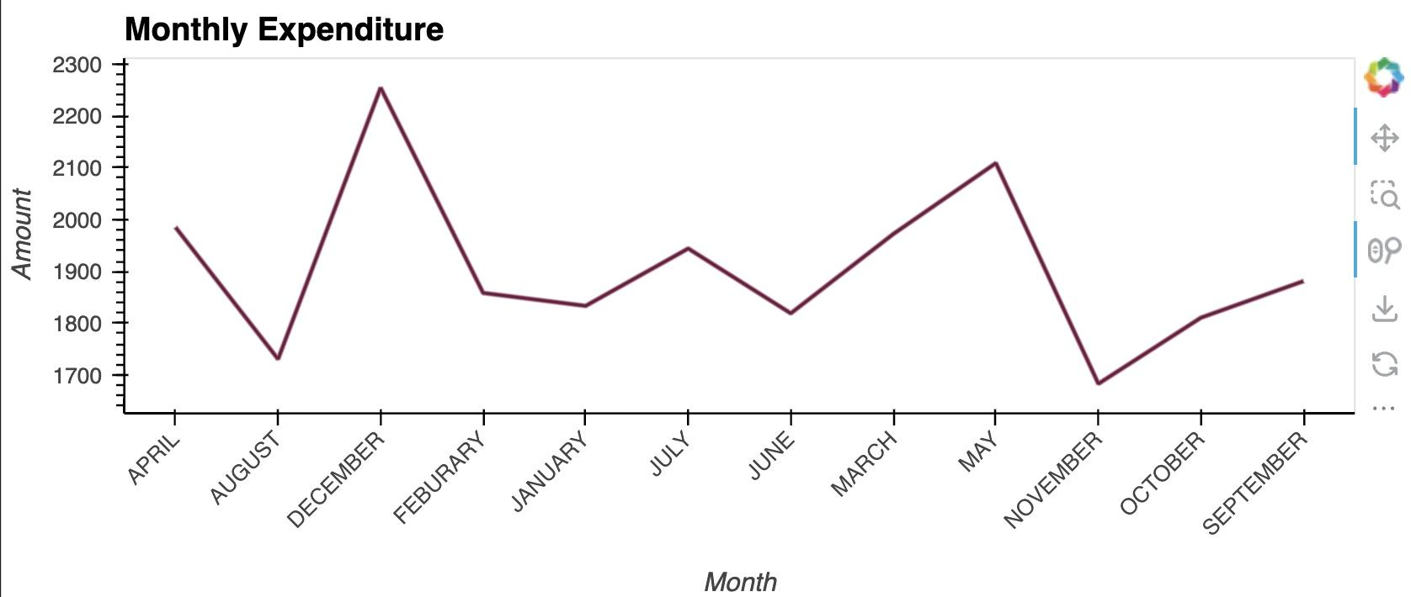
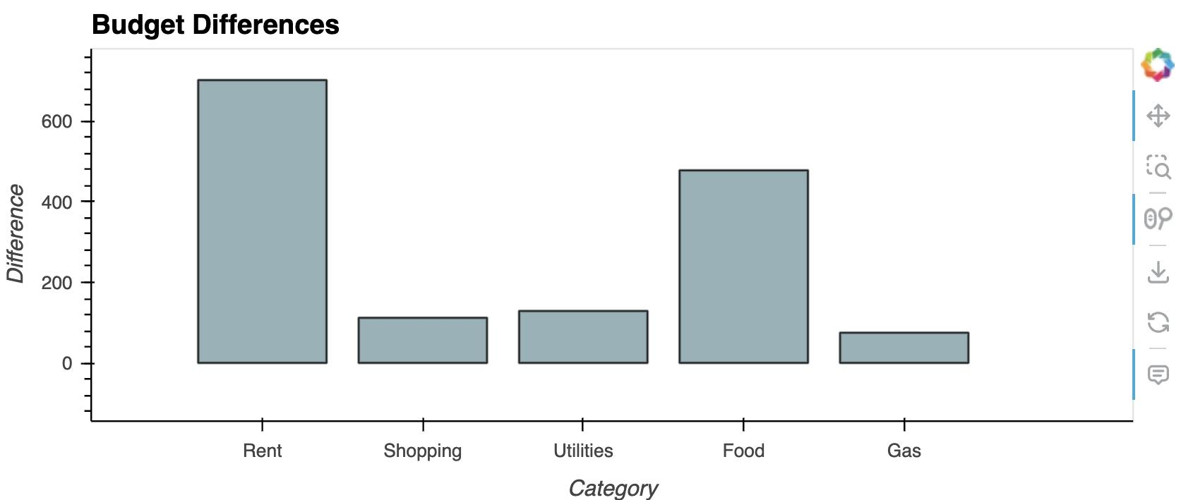
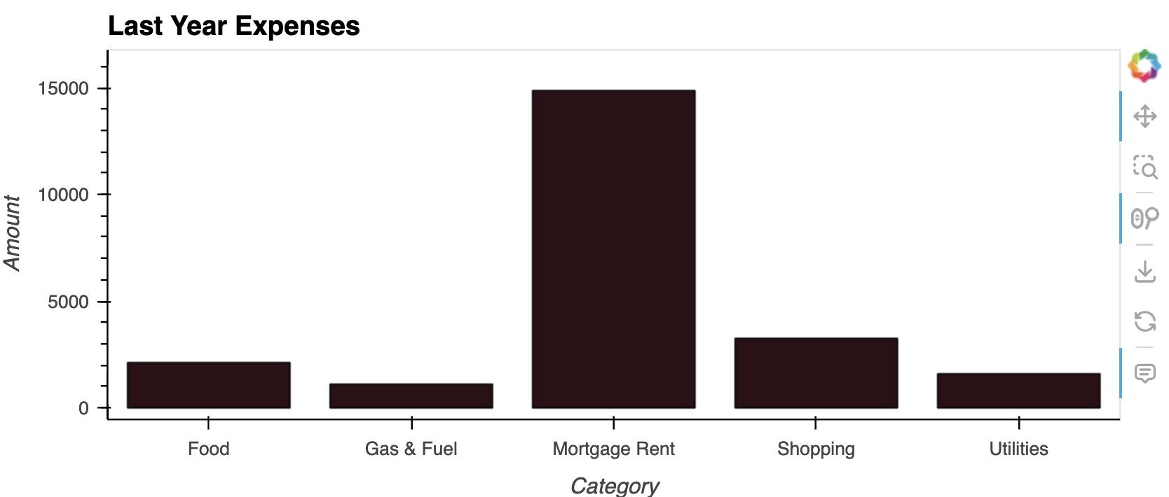
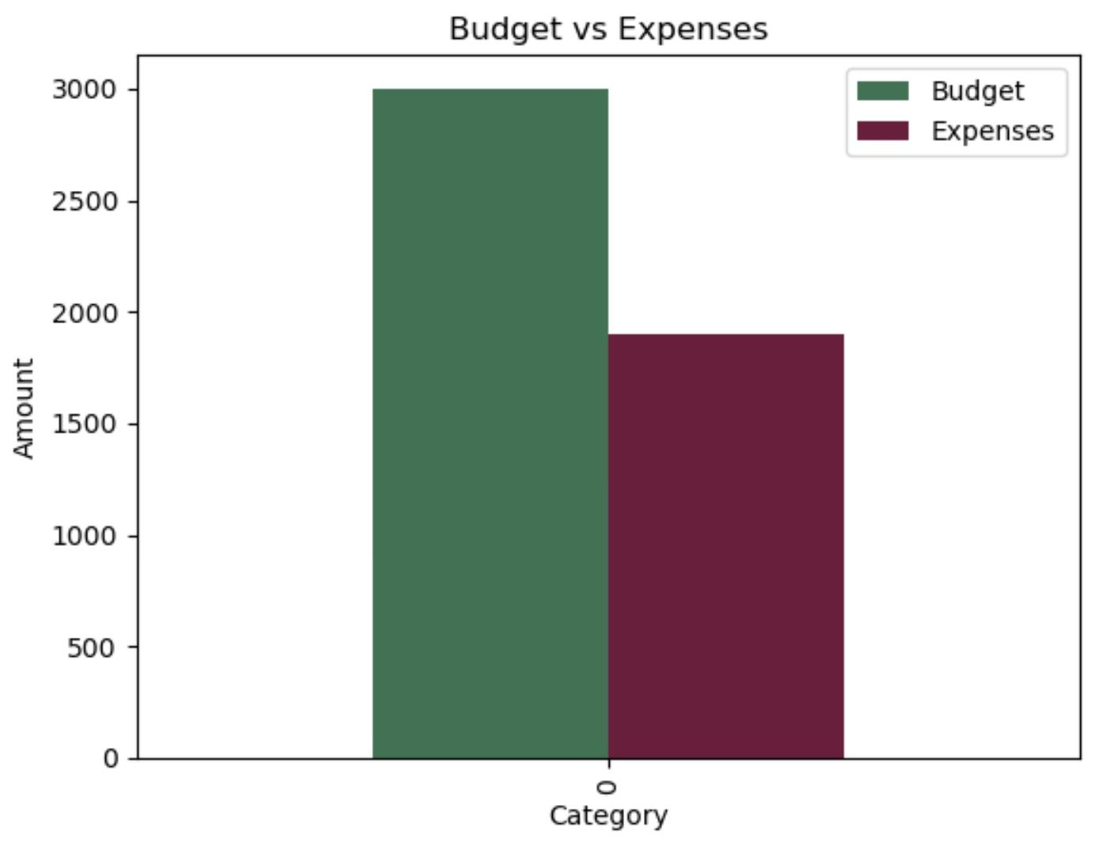
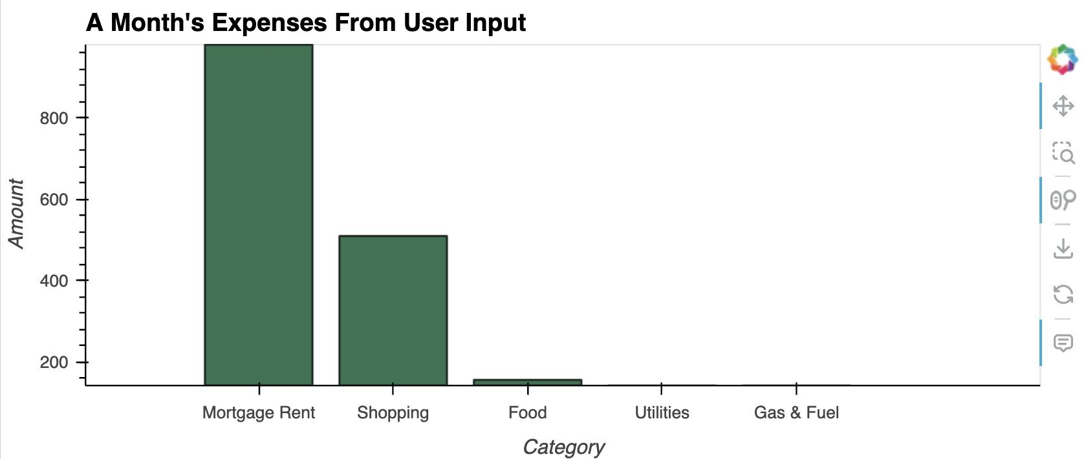
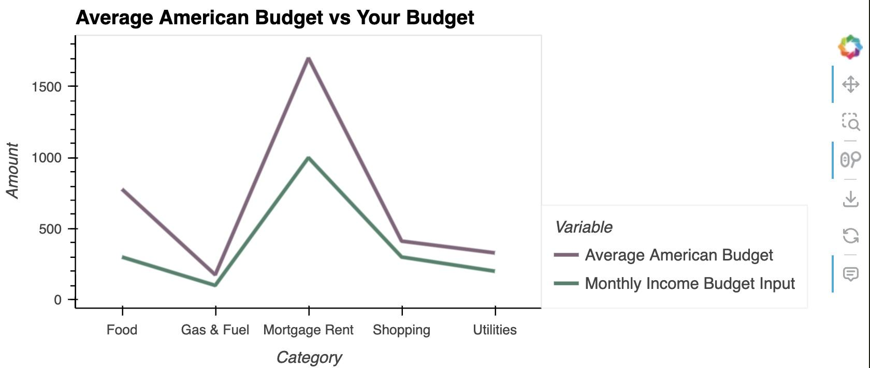
VISUALS

Slide 10
DISCUSSION
Surprises
User spending jumped from November to December (25% increase)
User’s spending was much lower than the average American in all categories*
Expectations
Housing payments were user’s greatest expense
General Conclusions
It is beneficial to understand your monthly finances, which allows users to adjust their spending habits/budget for “higher spend” months and prioritize saving during “lower spend” months
*User spent $25 more on gas than the average American
Notes:
Monthly expenditures: We were surprised his monthly spending varied so much, e.g. user spent $1,700 in November and $2,250 in December (25% increase)
Last year and monthly expenses: These results fell within our expectations. The user spent at least double on his housing payments than he did in any other category. This is also true for the average American.
Average American budget: It’s surprising how much lower our user’s spending was vs. the average American – with the exception of gas, which was $25 higher

Slide 11
POSTMORTEM
Difficulties
Amount of time spent researching how to create an effective financial tool
Making sure the function we wanted to create was not only doable but can tie together with current code
Finding different functions to implement visuals to code
If we had more time, we would…
Implement a code to see if user’s budget follow the 50-30-20 rule
Give users the option to edit their budget
Instead of having a fixed dataset, we would use an API to get more datasets/make it feasible to read
Learn more about widgets to implement them into the most of the code than only a portion

Slide 12
ANY QUESTIONS?

